Slide 1

Build your own Microsoft Teams using Microsoft Graph Toolkit and .NET Core API
Sohil Bhalla Microsoft 365 Expert Codeless Technology B.V. sbhalla@codeless.com
LinkedIn: https://www.linkedin.com/in/sohil-bhalla-46121434/
PnP Blog: https://pnp.github.io/blog/post/build-teams-using-graph-toolkit/

Slide 2
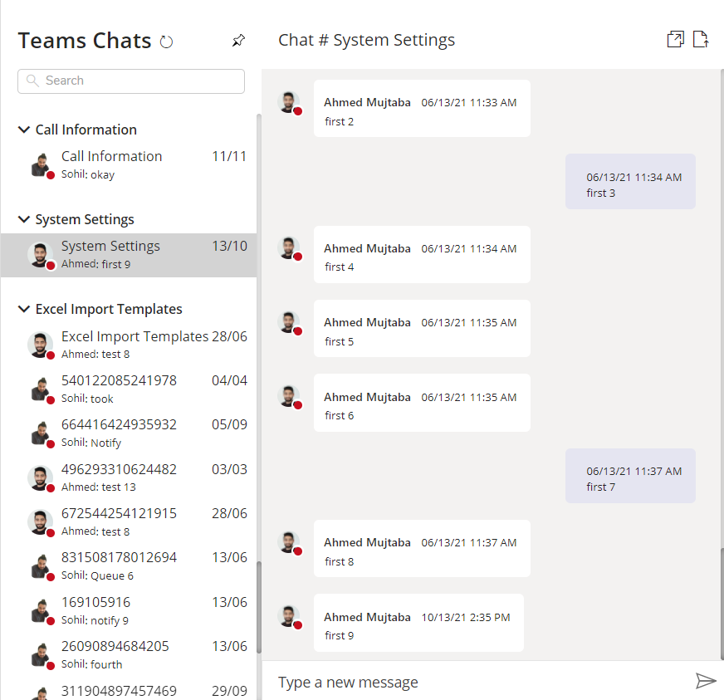
Business Case
Build Microsoft Teams in React Typescript and integrated with a web application using web components.
The Teams functionality should include:
Sending messages
Initiate chat
Receiving messages
Get notified
Show emojis

Slide 3





Architecture
Azure Active Directory
User | Channels
<userid> | Channel 1 Channel 2
<userid> | Channel 2
Create Subscription and extend subscriptions using Application permissions
AD Authentication
Subs | Expiry Date
Sub 1 | 14-04-2021 14:00:00
2
Expiry ~ 1Hr
6
App service publish message
Channel | Messages
Channel 1 | Message 1 Message 2
Channel 2 | Message 1 Message 2
1
List of Channels to Subscribe (Teams Subscribe End Point)
SignalR Endpoint
Azure App Service
2
AD Authentication
Receives the message
5
MS Graph
8
Calls Proxy Endpoint with last message id to get the Teams Data
3
Graph Sends Notification On Change
3
Graph Sends Notification On Change
Calls the webhook endpoint
4
4
Calls the webhook endpoint
List of Channels to Subscribe (Teams Subscribe End Point)
1
5
Receives the message
7
SignalR Publishes the message to the client
6
App service publish message
7
SignalR Publishes the message to the client
Web Application
8
Calls Proxy Endpoint with last message id to get the Teams Data

Slide 4
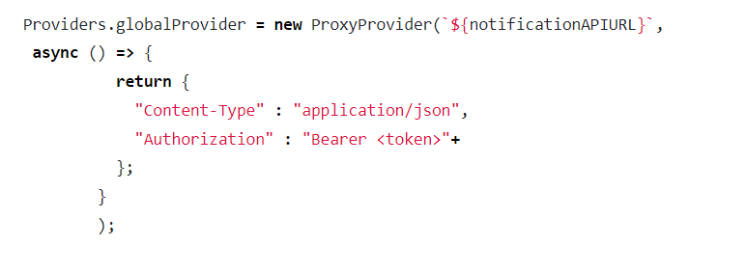
Graph Toolkit Provider
Proxy provider that will redirect all the request from the Graph toolkit components to my custom .NET Core API

Slide 5
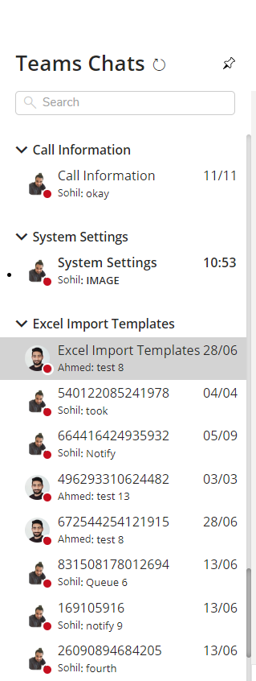
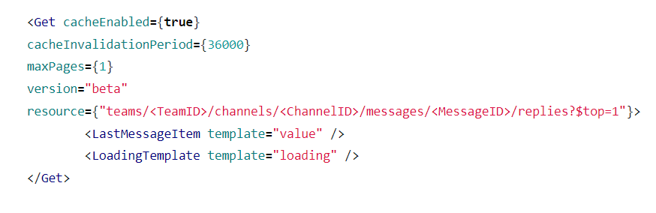
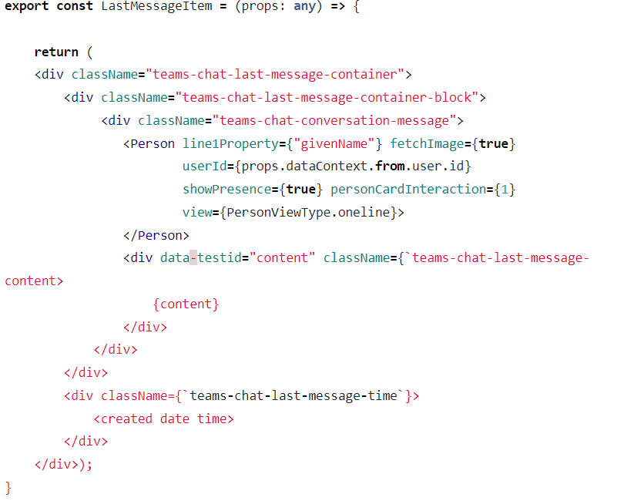
Left Side Screen Component

Slide 6
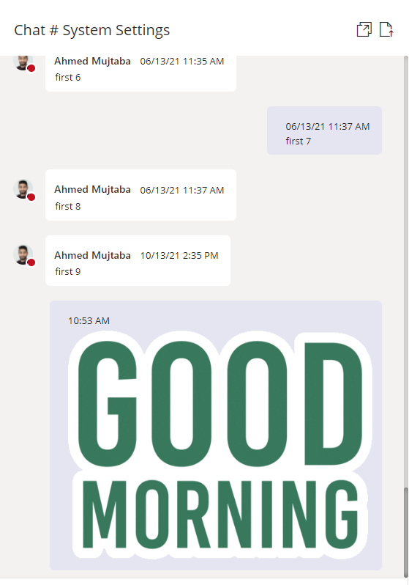
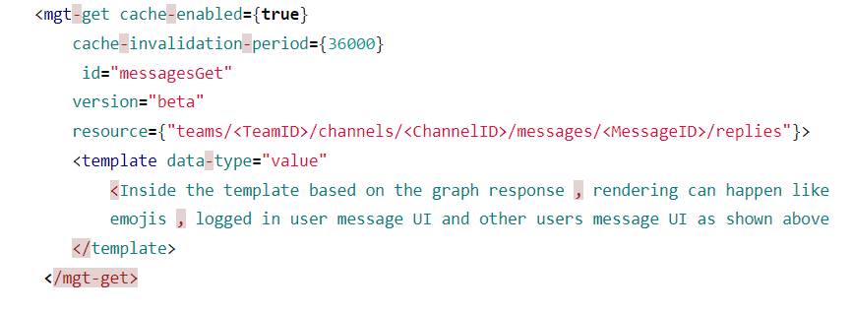
Right Side Screen Component

Slide 7
Back End Implementation ( .NET 5 )
Involves development of .NET core API and manages:
User authentication
Graph change subscription
SignalR management with groups
Respond to all the graph calls (acting as a provider in the Microsoft Graph toolkit proxy provider)

Slide 8
Graph Change Subscription
A subscription allows a client app to receive change notifications about the changes in data in Microsoft Graph.
Sample request to Graph:
https://graph.microsoft.com/v1.0/subscriptions
{
"changeType": "created,updated,deleted",
"notificationUrl": "<API Endpoint URL>",
"resource": "teams/<teamid>/channels/<channelid>",
"expirationDateTime": "2021-06-24T12:45:45.9356913Z",
"clientState": "Y29kZWxlc3M=",
"latestSupportedTlsVersion": "v1_2"
}

Slide 9
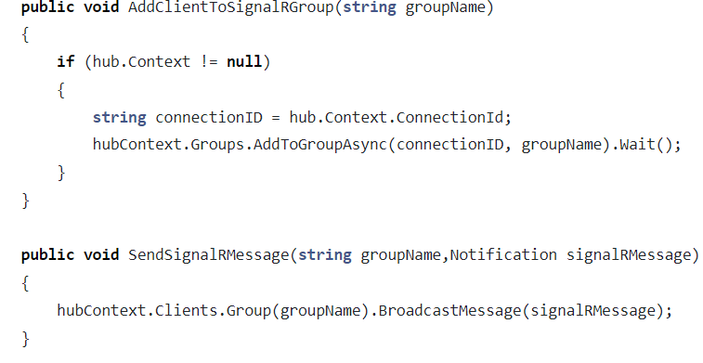
SignalR Implementation
SignalR is used to send notifications to the client for any new messages posted on the MS Teams channel

Slide 10
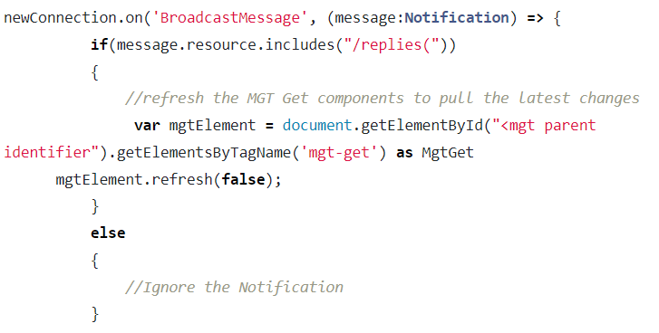
Client Side Changes to Get latest messages from Teams
The backend API is now ready to serve the client requests.
Once the client receives a message from signalR, the MGT Get component will refresh the data by calling the refresh method of the MGT component.

Slide 11
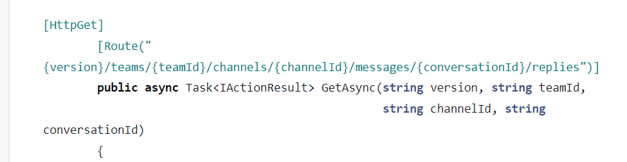
Respond to All Graph Calls (Proxy Provider)
The backend API will expose an endpoint that responds to all the Graph calls from the client.
This includes:
Get new messages
Profile information (Including profile card)
Presence indicator

Slide 12
Final Demo

